Slide 1



XData e Aurelius Do Server ao Mobile uma FrameWork completa
Juliomar Marchetti
juliomarmarchetti@gmai.com

Slide 2

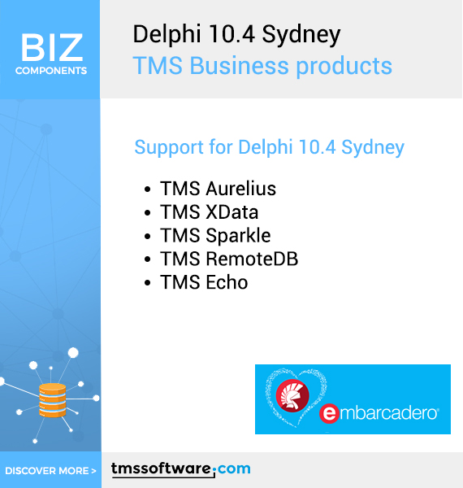

Slide 3
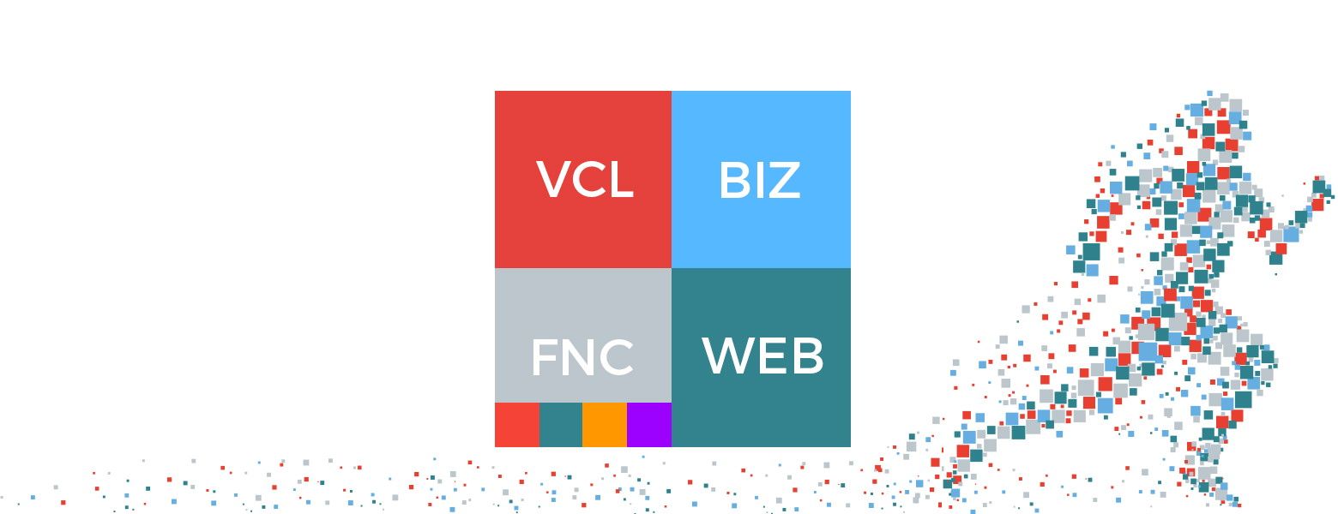
TMS Software
TMS Software | VCL, FMX, ASP.NET, .NET controls & components for Delphi, C++Builder & Visual Studio | TMS Business Subscription

Slide 4
Ação

Slide 5
Obrigado
juliomarmarchetti@gmail.com
https://www.juliomarmarchetti.com.br

